Slide 1

Applying and Extending The lee-Carter Model

Slide 2
Aims
Understanding and applying the Lee-Carter model to UK mortality data.
01
Adapting the Lee-Carter model to incorporate local areas within the UK rather than age groups.
02
Proposing, testing and applying an extension to the Lee-Carter model to consider age, time and local area.
03

Slide 3
Why?
Being able to analyse and forecast mortality plays a significant role in decision making in areas like public health, insurance and government.
The importance of mortality modelling has been indicated now more than ever as a result of the COVID-19 pandemic.
The Lee-Carter model is a stochastic model that was derived over 30 years ago, and therefore presents the opportunity to be built upon with more modern techniques.
Stochastic modelling is already commonly used tool in business to predict outcomes of random variables.

Slide 4
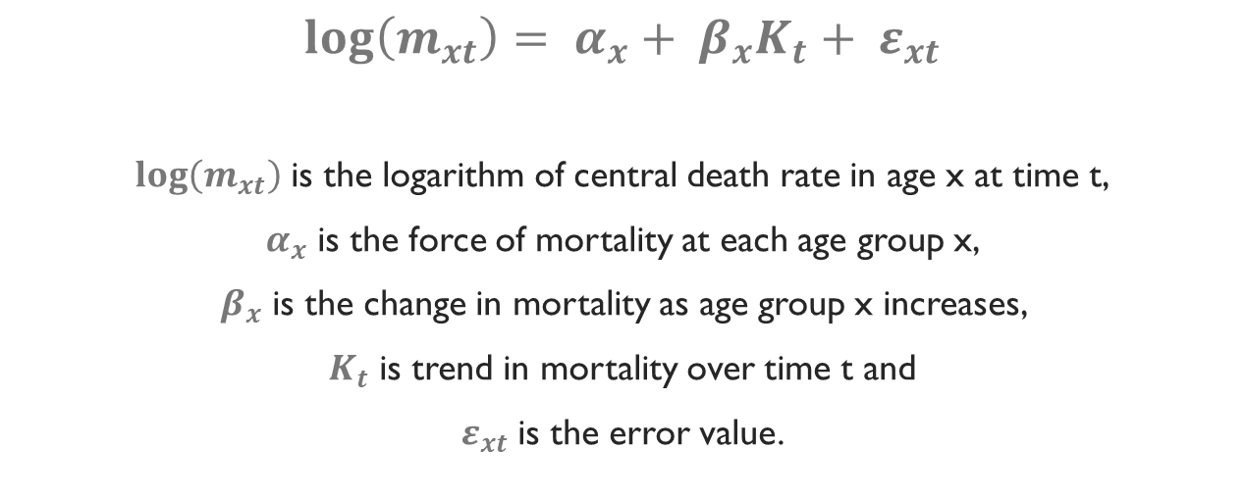
What is the Lee-Carter model?
$$\log\left(m_{xt}\right)= α_{x}+ β_{x}K_{t}+ ε_{xt}$$
$\log\left(m_{xt}\right)$ is the logarithm of central death rate in age x at time t,
$α_{x}$ is the force of mortality at each age group x,
$β_{x}$ is the change in mortality as age group x increases,
$K_{t}$ is trend in mortality over time t and
$ε_{xt}$ is the error value.

Slide 5
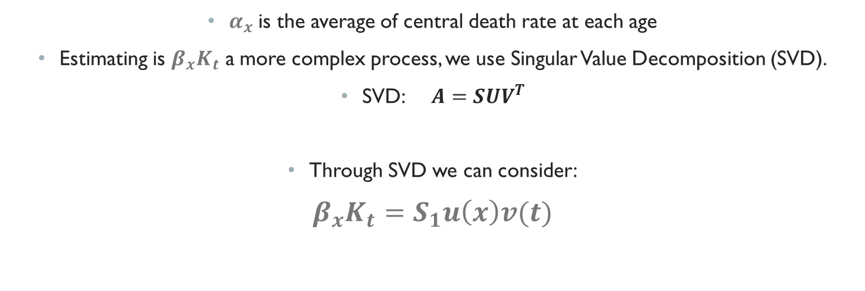
Estimation of variables
$α_{x}$ is the average of central death rate at each age
Estimating is $β_{x}K_{t}$ a more complex process, we use Singular Value Decomposition (SVD).
SVD: $A=SUV^{T}$
Through SVD we can consider:
$β_{x}K_{t}=S_{1}u\left(x\right)v(t)$

Slide 6
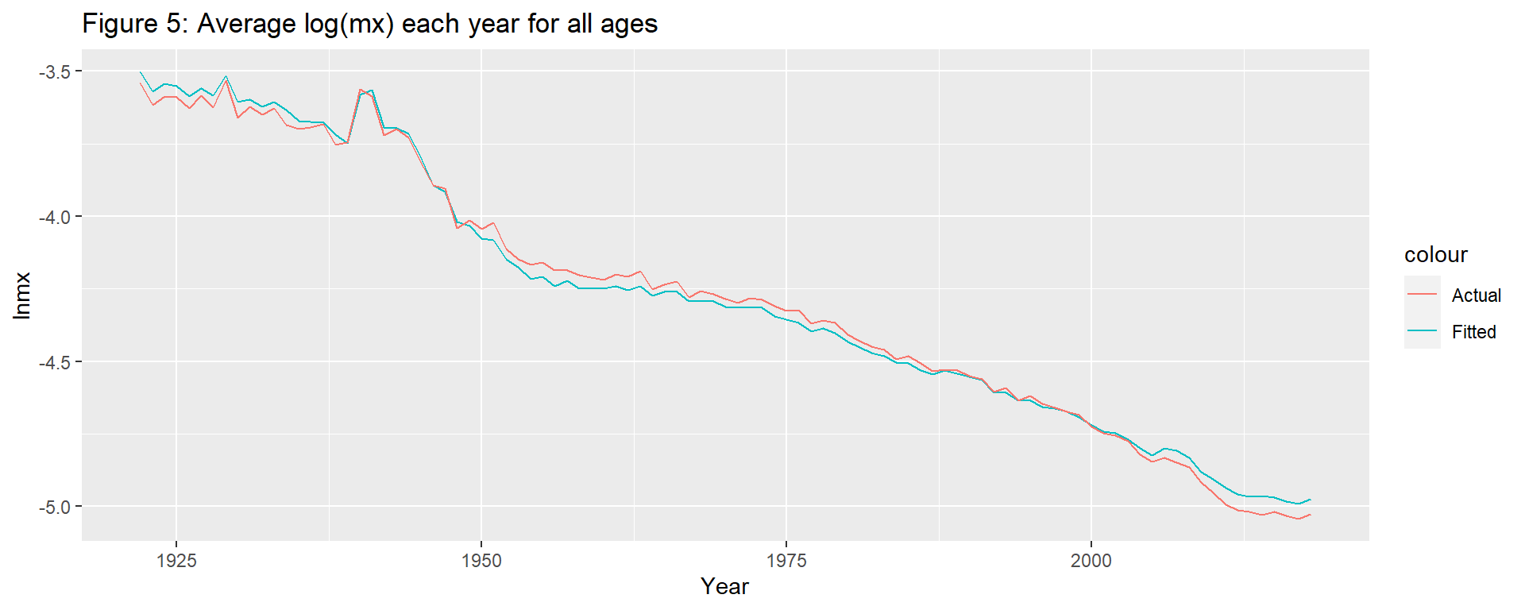
Applying the Lee-Carter model

Slide 7
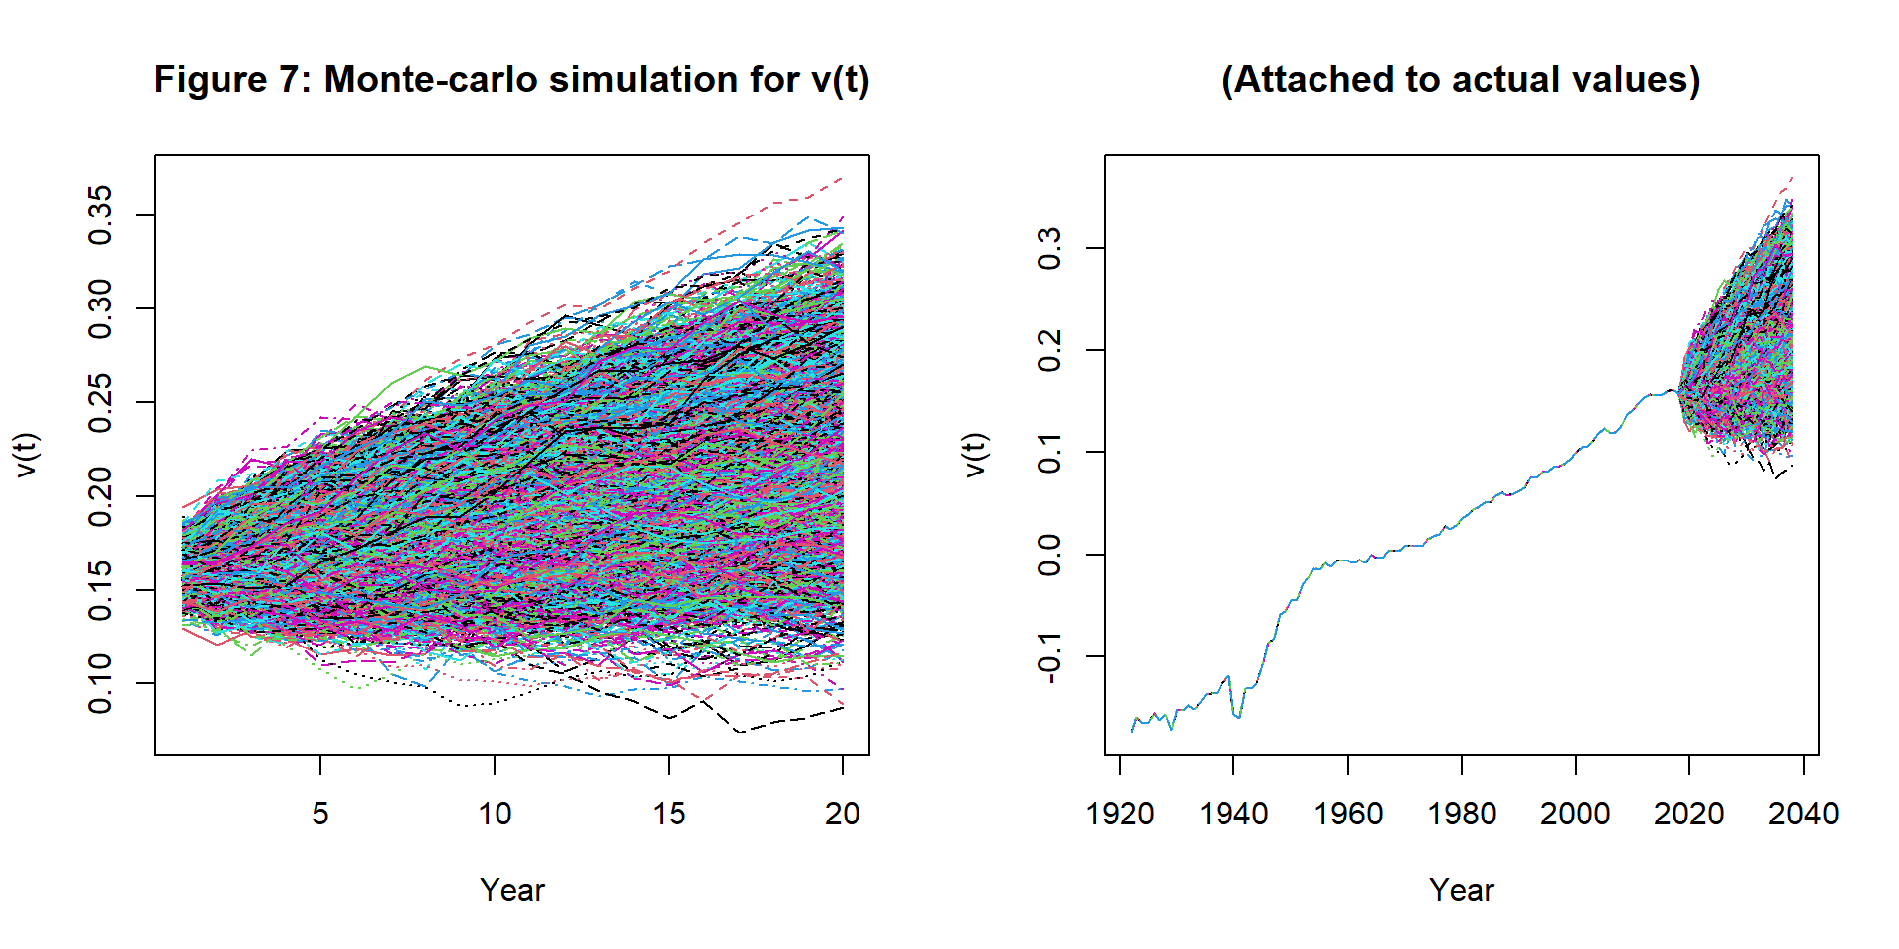
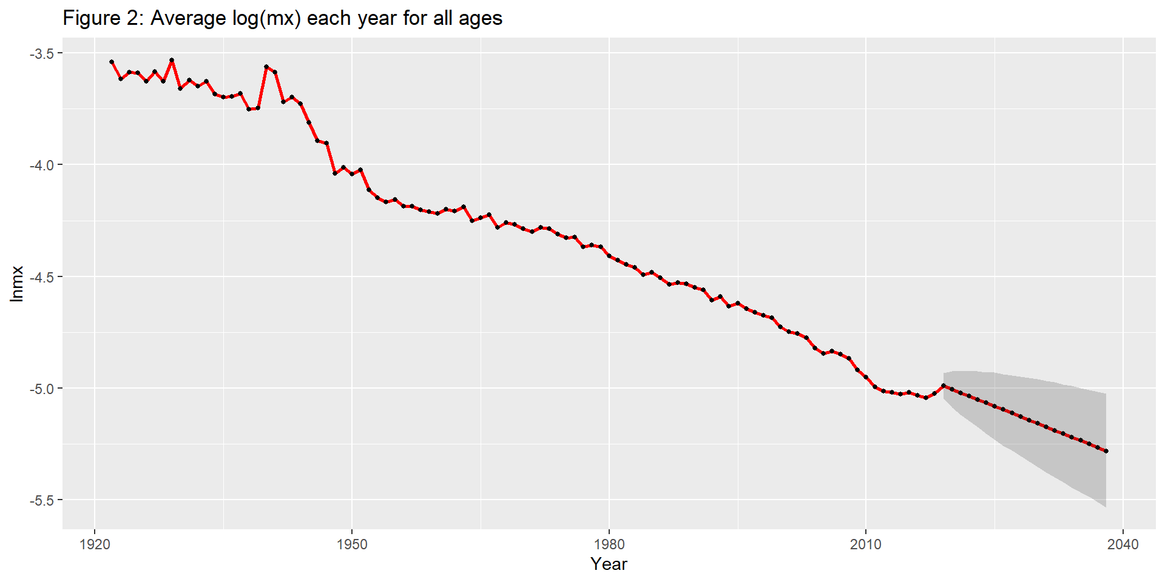
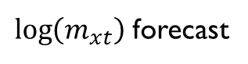
Forecasting (monte-Carlo)
v(t) forecast
$\log\left(m_{xt}\right)$ forecast

Slide 8
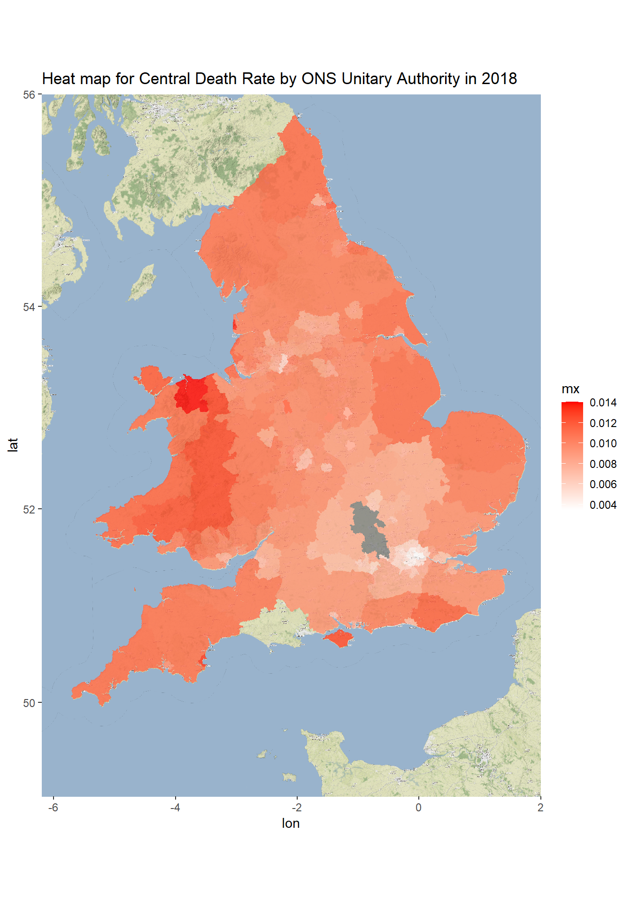
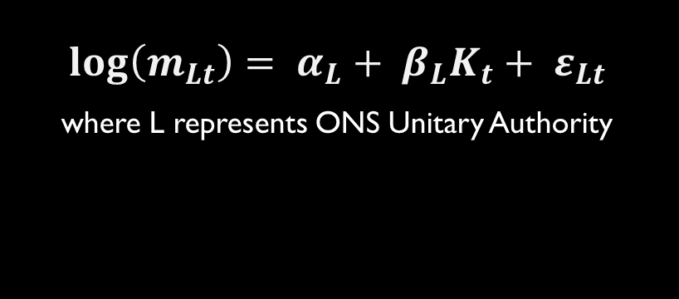
Looking at local areas
$$\log\left(m_{Lt}\right)= α_{L}+ β_{L}K_{t}+ ε_{Lt}$$
where L represents ONS Unitary Authority

Slide 9
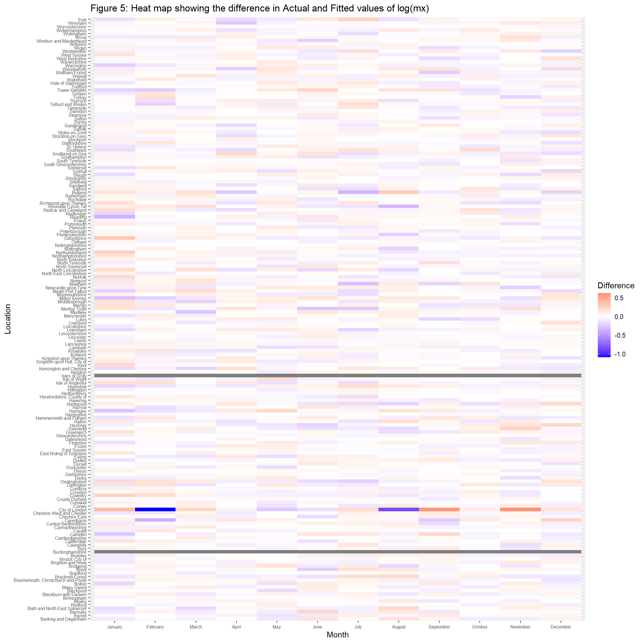
Difference in fits

Slide 10
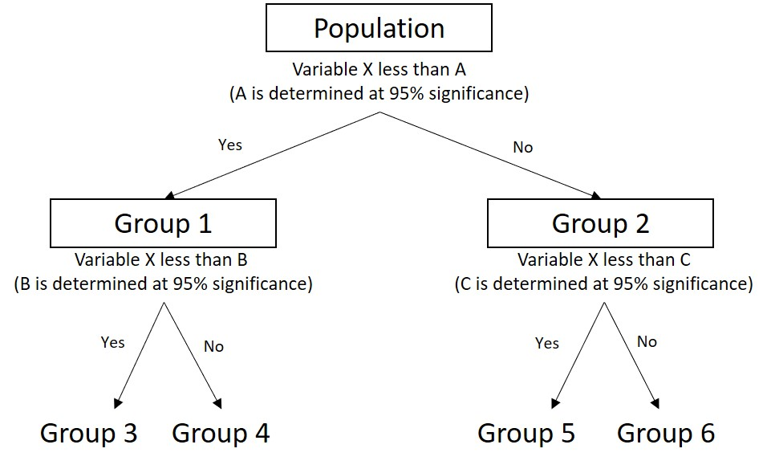
Classification trees

Slide 11




Groups
Group 3
Group 1
Group 4
Group 2

Slide 12
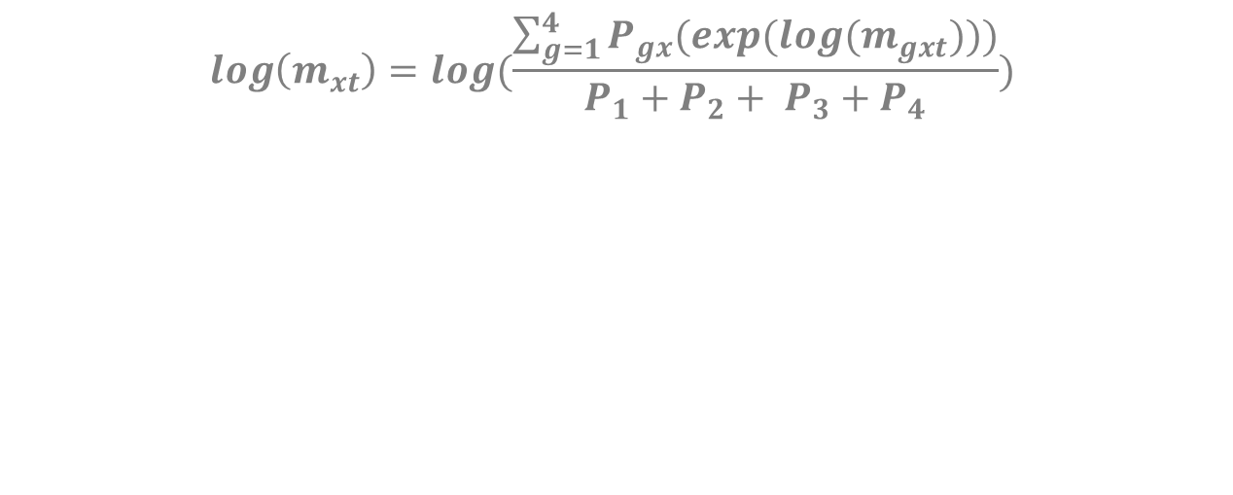
Extension to the Lee-Carter model
$$\log\left(m_{xt}\right)=log⁡(\frac{\sum_{g=1}^{4}{P_{gx}(exp⁡(log⁡(m_{gxt})))}}{P_{1}+P_{2}+ P_{3}+P_{4}})$$

Slide 13
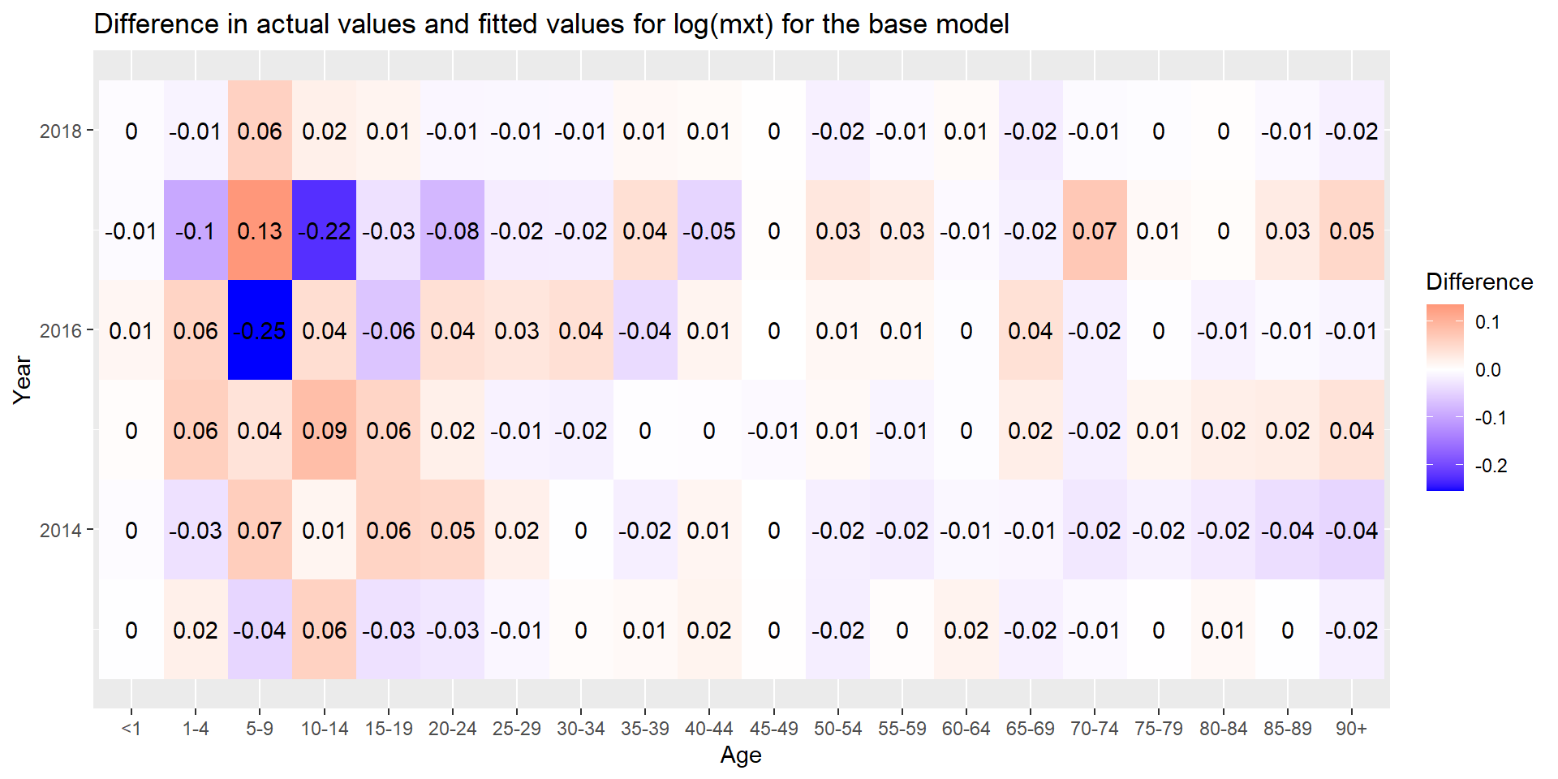
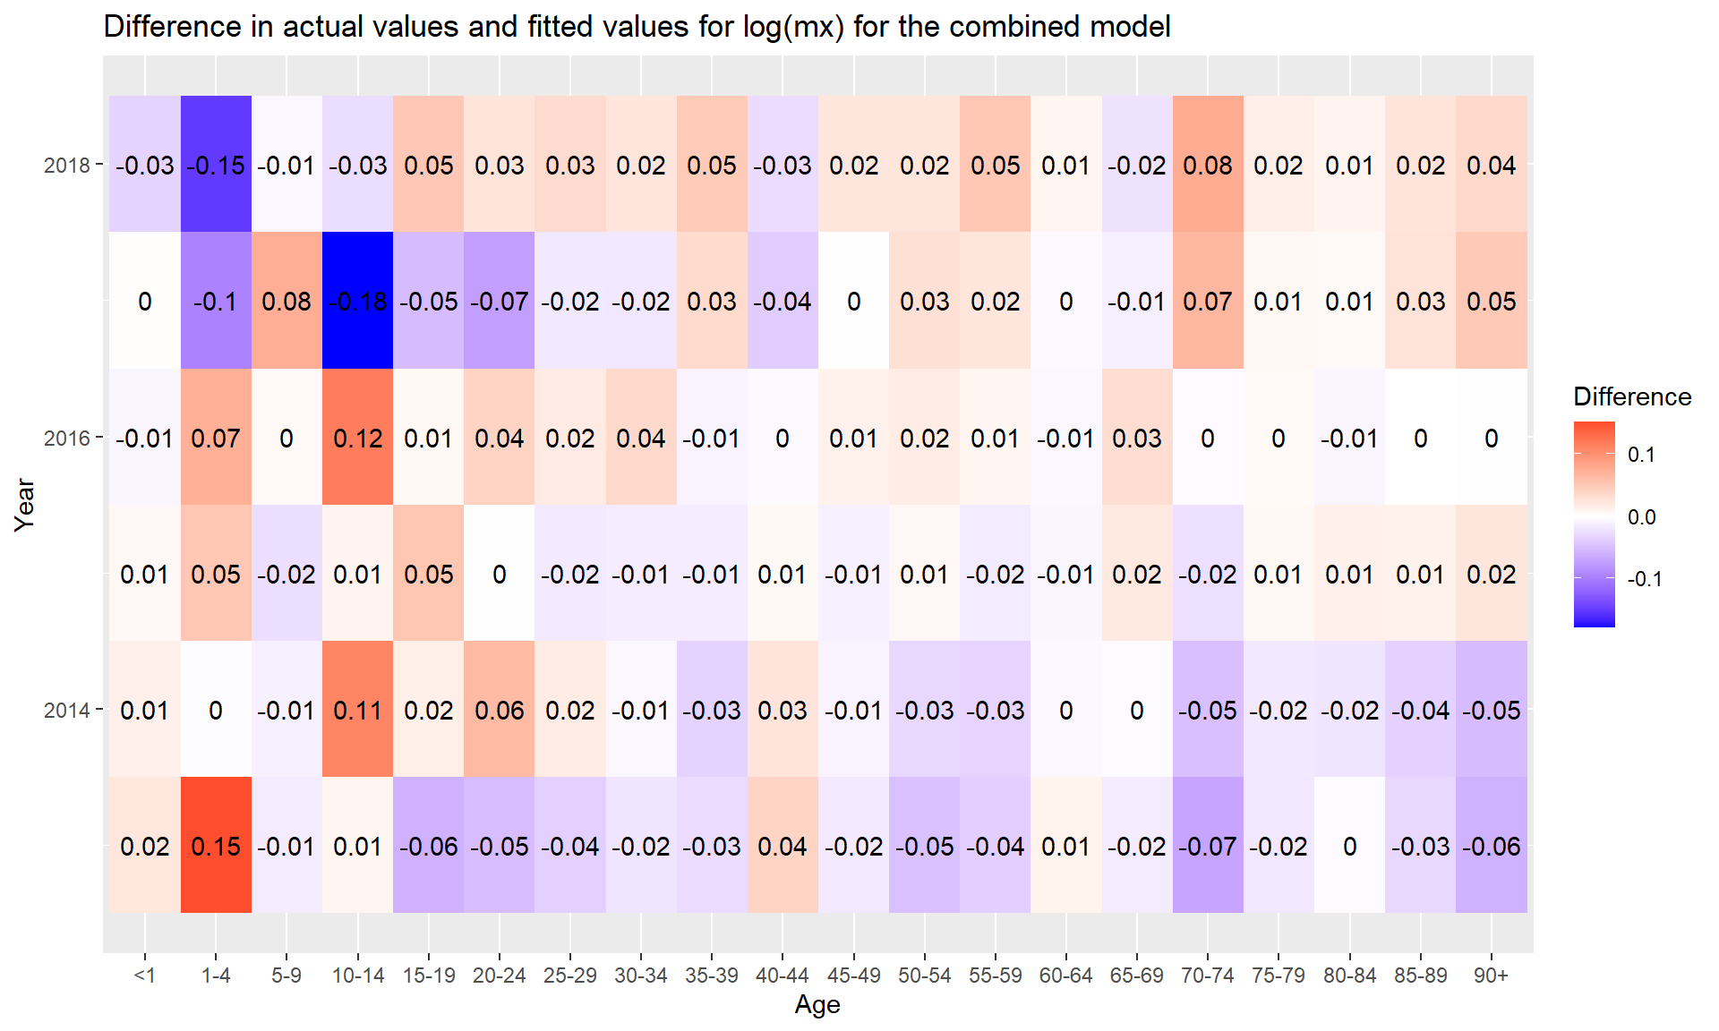
Comparison of difference in fits
Lee-Carter model
extension

Slide 14
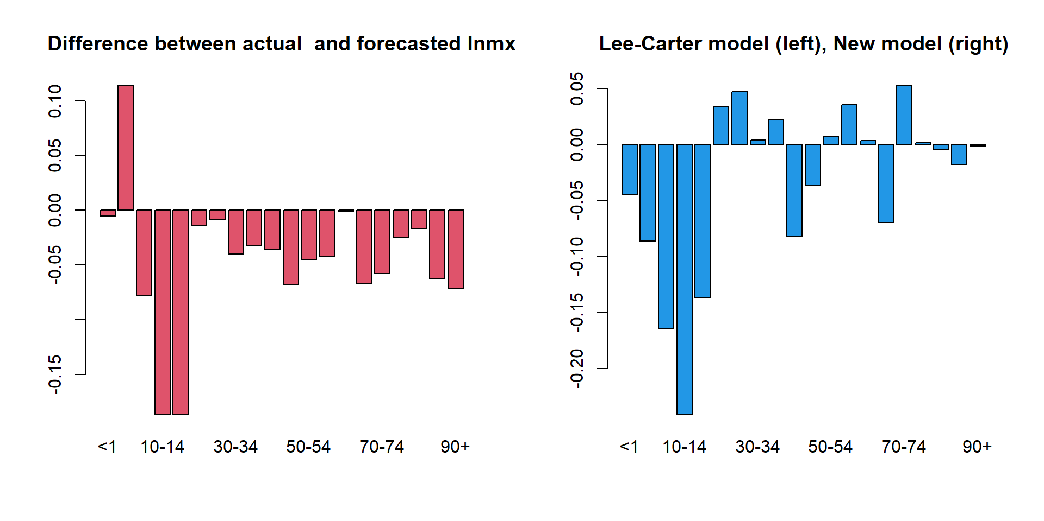
Forecasting

